Slide 1

System Administration
2-Linux Command Line Interface & Common Commands

Slide 2
Today,
Introduction to Ubuntu
Common Commands

Slide 3
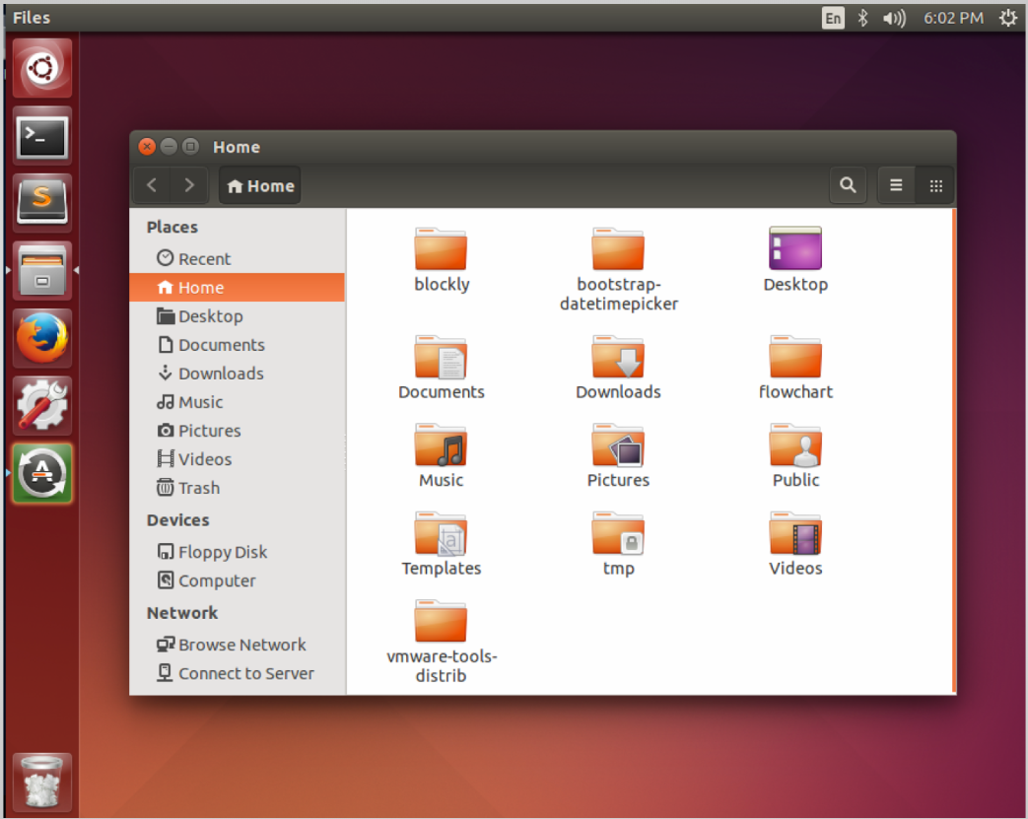

Slide 4
Ubuntu History
Based on the Debian Linux system
4.10 - Warty Warthog (Oct. 2004)
New releases every 6 months
14.04 - Trusty Tahr (LTS): 5 years of security updates
15.10 - Wily Warewolf
16.04 - Xenial Xerus (LTS)

Slide 5
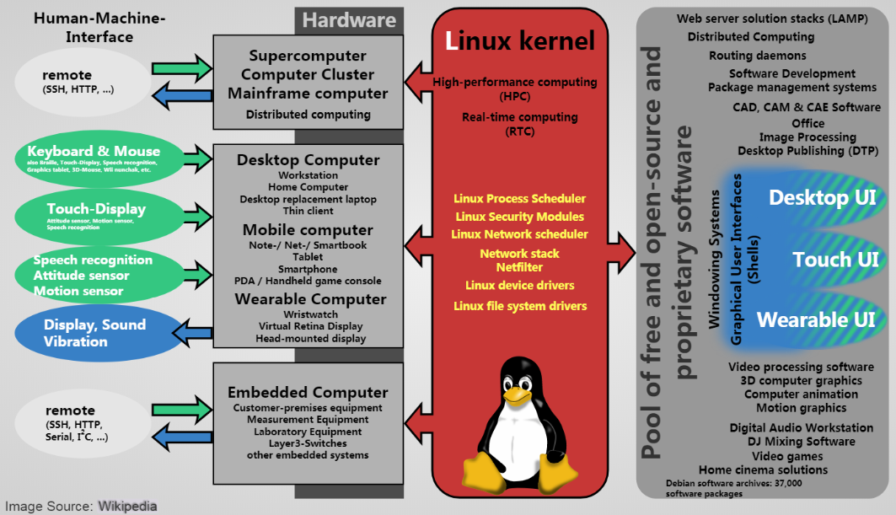

Slide 6
Major Ubuntu Components
GNOME Desktop with Unity
System Settings
Software Center
File System Layout
Configuration Files
The Terminal

Slide 7
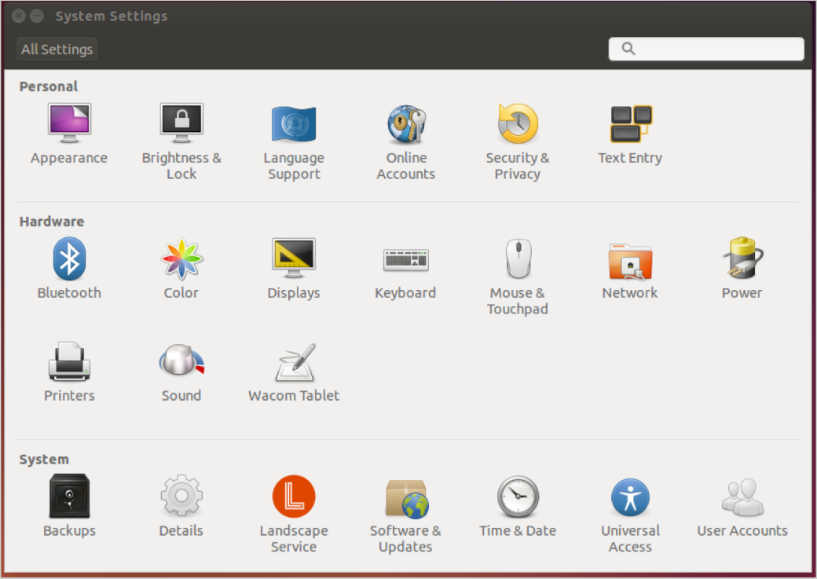

Slide 8
Filesystem Layout
bin - Binary utilities
dev - Devices (as files!)
etc - Configuration files
home - User files
lib - Shared libraries
usr - User Programs
var - Variable data (logs)

Slide 9
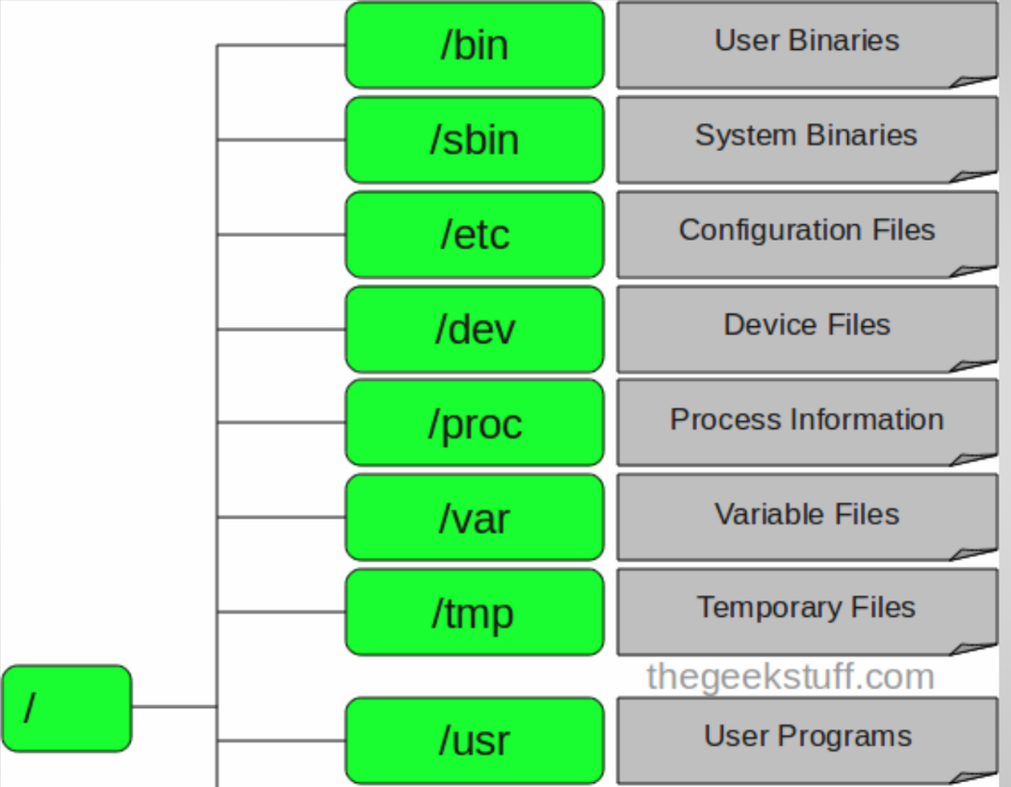

Slide 10
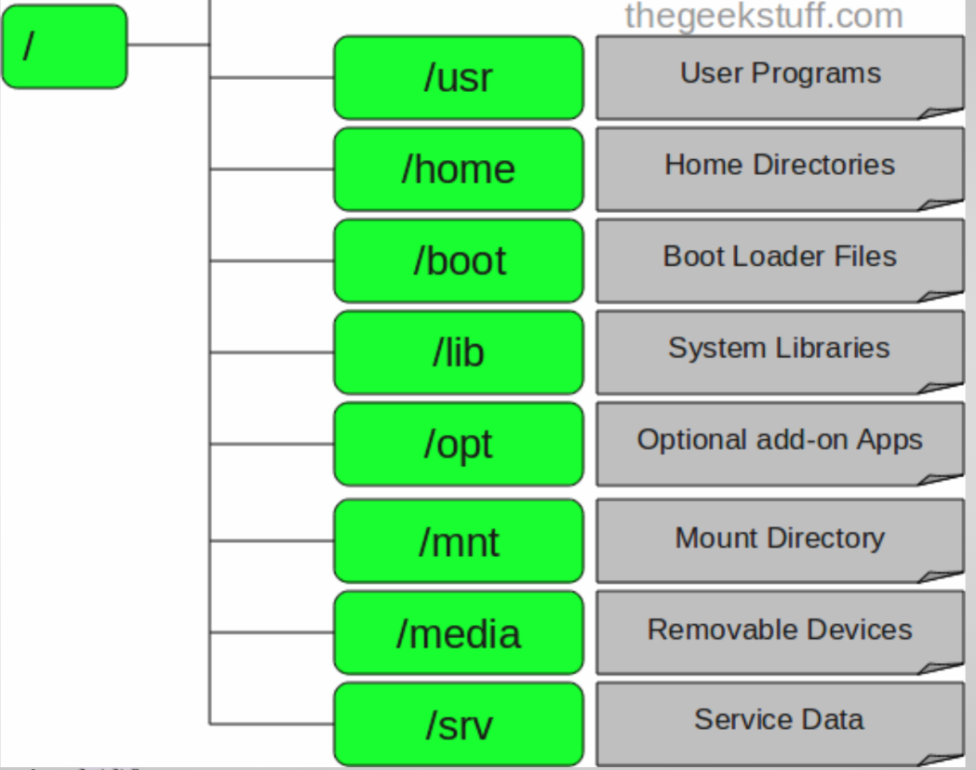

Slide 11
Configuration Files
Most Linux programs store configuration in text files
They can be found in /etc
Usually requires administrator access to edit them
MAKE BACKUPS! BE CAREFUL!

Slide 12
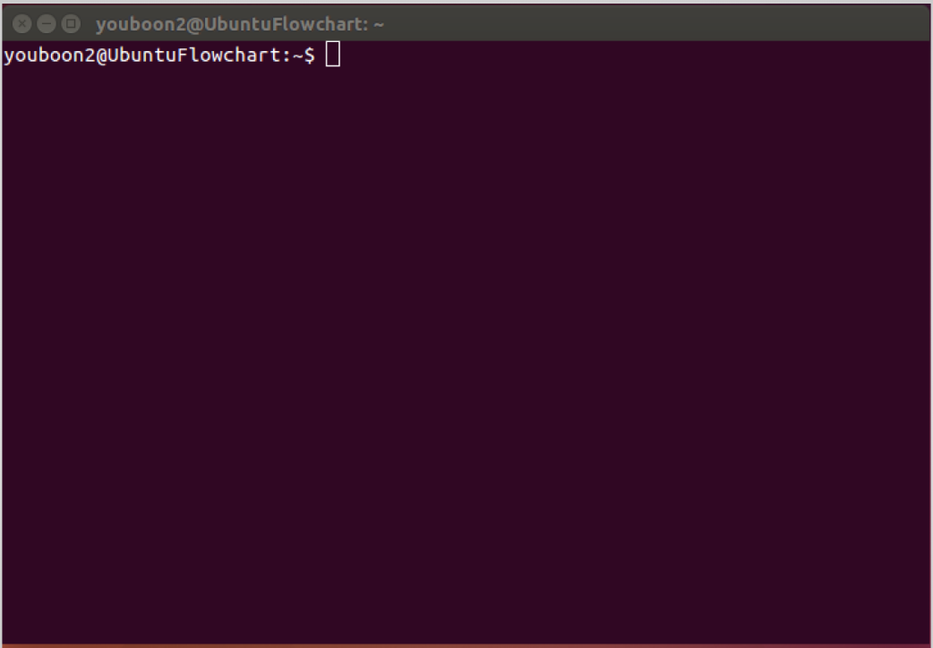

Slide 13
Ubuntu Boot Process
BIOS looks for a bootloader in first sector of the disk
Typically either GRUB or LILO
The bootloader loads the kernel and the initial ramdisk (initrd)
The root filesystem is found, mounted, and init start loading processes
Notes:
Ramdisk is used to mount root file system 守护进程
Init is the first user process started by kernel, process id is 1

Slide 14
Ubuntu Boot Process
The desktop environment is loaded (GNOME, KDE, etc.)
Other services are loaded in parallel
The system is ready for use

Slide 15
Linux Commands (I)
pwd - Get current directory
cd - Change directory
ls - List files
mkdir - Make new directory
rmdir - Remove directory
rm - Remove file
cp - Copy file
mv - Move file

Slide 16
Linux Commands (II)
grep - Search for text
wc - Get word count
cat - Print files
sort - Sort items
apropos - Find commands
whereis - Find command location
whatis - Find command descriptions
man - Find command help

Slide 17
Linux File Permissions
ls -al - Find file permissions
  [user][group][others]
  r = read; w = write; x = execute
  rwxr--r--
chmod - Change file permissions
chown - Change file ownership
sudo - Run as administrator
script - Record commands in text file

Slide 18
File Output
> Output to a file (overwrite)
>> Output to a file (append)
| Pass output of one command to another

Slide 19
Special Directories
./ Current Directory
../ Parent Directory
~/ Home Directory
/ System Root
- Previous Directory (Linux)

Slide 20
Building Shell Scripts
Open a new file using a text editor
Add the following header at the top

Slide 21
Building Shell Scripts
Input commands below (1 per line)
Save the file (CTRL + X) and run
cd ~/bin
ls -al
$ chmod u+x ./script.sh
$ ./script.sh

Slide 22
Shell Hello World
#!/bin/bash
echo "Hello World"
exit 0

Slide 23
Shell Hello World
echo prints text
exit stops the command
More Shell Scripts Latter
echo "Hello World"
exit 0

Slide 24
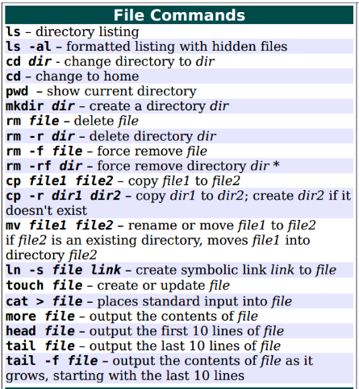
Regular Commands

Slide 25
Examples
mkdir directoryname
cd .. #back to the parent directory
cd . #stay in the current directory
cd directory/directory/directory #changing to the targeting directory.
ls /ttt/ #listing all files and directories in the directory /ttt/

Slide 26
du
To find out how much disk space is being used by a file or directory, use the du command
The general form is du [-s] [-h] file(s)
The -s options tells du not to show sizes for every file found, but instead display a total for all the files
The -h option tells du to show sizes in human-friendly numbers instead of byte counts

Slide 27
Creating Directory
Directories are created using mkdir
Multiple directories can be created by putting multiple pathnames on the command line as arguments
mkdir requires write and access permissions (wx) on the directory which will contain any directory being created

Slide 28
Removing Directory
Directories are removed using rmdir
Multiple directories can be removed by putting multiple pathnames on the command line as arguments
rmdir requires write and access permissions (wx) on the directory which contains any directory being removed

Slide 29
Removing Directory
rmdir requires a directory to be empty before it can be removed (i.e. it cannot create orphan files)
rm -r can be used to recursively remove a directory and the entire file hierarchy it contains

Slide 30
Moving Directory
Directories can be moved trivially within filesystem containers using the mv command (mv source(s) destination) because it is essentially just a change of containing directory for the directory being moved
Multiple sources may be specified if the destination is an existing directory

Slide 31
Creating Regular Files
Regular files can created by any command capable of writing data to a file as long as you have write and access permission (wx) on the containing directory
Shell redirection can save the output of any command to a file, creating it if necessary (cat xxx > yyy)

Slide 32
Creating Regular Files
touch pathname(s) can quickly create empty regular files
Editors are also commonly used to create regular files

Slide 33
Remote Files
There are several programs which are helpful when you want to retrieve some file(s) from a remote machine
If the remote machine is one you have an account on, you can try ftp or sftp to transfer the file(s) of interest
If the remote machine is a web server, you can use wget or curl to retrieve the file(s)

Slide 34
Wget & curl
They have different default behaviours
wget URL retrieves a file and stores it using the same name it had in the URL
curl URL outputs the file contents onto your screen by default (curl URL > /xxx/text)
Both have many options to allow you to control the download, perform upload, etc
Notes:
Both wget and curl give you a way to retrieve a local copy of some file(s) from web servers, as well as upload data to those web servers using http and https protocols

Slide 35
Finding Files
The ls command allows visually inspecting directory lists, but isn't usually very helpful to locate lost files
The locate command can be used to find files, but depends on a database which may not be accurate
The whereis command helps you find files in specific system directories, not helpful for finding lost user files

Slide 36
find
It allows you to perform complex commands on the files found, or you can just list them out as found
The general form is
find [starting-pathname] [options] [pattern(s)] [actions-to-take]
find ~ -name "*.txt" -print
find . -name "[A-Z]*" -print
Notes:
The find command is the general-purpose file finding tool
It allows searching for files based on many different characteristics or combinations of them, or simple searching by name

Slide 37
Reference
<Linux入门教程-v1.0>第6章
“man” is always perfect.
e.g., Type “man ls” in command line, you could get all information about “ls”.

Slide 38
Project 2
Please Finish Project 2, and submit all project document to jwangdr@aliyun.com by the end of next Wednesday (Mar. 11)

Slide 39


